Slide 1
Predicting Restaurant’s Ratings

Slide 2
Data sources
Most restaurant’s ratings and features can be found on popular websites/apps like zomato, swiggy, uber eats but making a distinctive dataset out of that information is not easy as they don’t provide rating on whole for every restaurant, we need to give restaurant names one by one and then get the results. What we can do instead is to use Zomato API which returns a list of restaurants for every location when given an input in form of neighbourhood name and the radius from that location. The location of all neighborhoods can be retrived from Foursquare API or geacoders API of Python when fed with the name of the locality. Then names we can get by locating a website with a list of pincodes of Bangalore and the particular name of the localities inside that pincode as such are codes can have multiple societies under one pincode .

Slide 3
Data Cleaning
The location coordinates got from the geocoders API are not exactly coorect as some coordinates are wrong as we can see that by plotting them all on a map thus we need to eliminate the rows which have values not corresponding to Bangalore’s coordinated area. We also need to remove any other rows which might not be useful for the analysis as we go on.

Slide 4
Feature Selection
I’ll select these features :
'Neighbourhood',
'Neighborhood Latitude',
'Neighborhood Longitude',
'restaurant',
'restaurant id',
'Cuisines', ‘
avg cost for two',
'Rating', 'has online delivery',
'has table booking',
'Total Rest. in area'

Slide 5
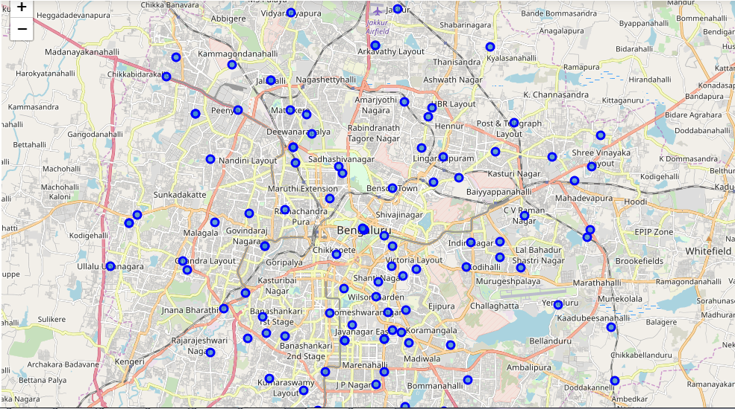
Plotting Location Coordinates for checking

Slide 6
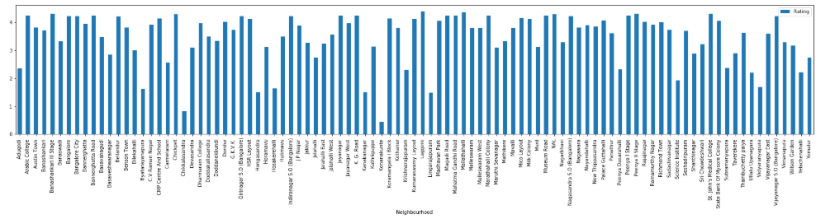
Ratings wrt Neighbourhoods

Slide 7
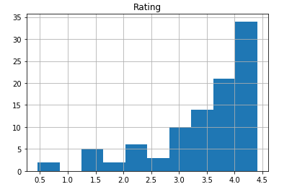
Absolute Ratings

Slide 8
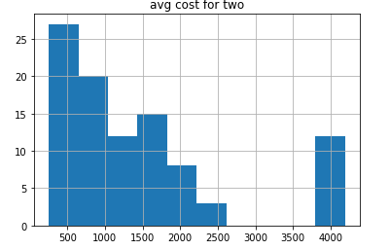
Avg. Cost for two absolute values

Slide 9
Clusters
I applied KMeans algorithm to make clusters of the data visible so as to make different clusters of restaurants based on their ratings, avg cost, online presence , bookings , etc. I plotted these clusters then to get a visual confirmation of the palpability of these clusters and to see if they are that wide distributed.

Slide 10
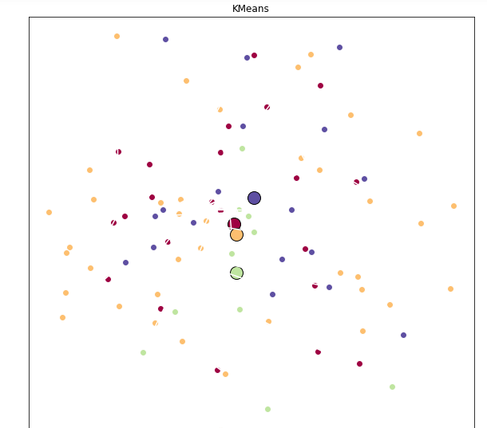
Clusters

Slide 11
Predictive Analysis
I applied the K nearest neighbors predictive algorithm & Support Vector Machines algorithem to predict values of the ratings with respect to the features we selected earlier.

Slide 12
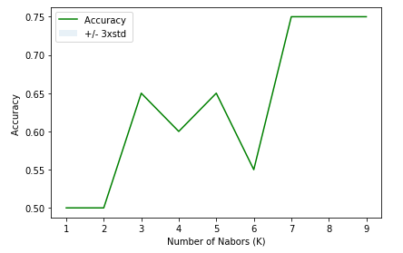
KNN algo

Slide 13
Accuracy of KMeans
Train set Accuracy | 0.7532467532467533
Test set Accuracy | 0.75
F1 score | 0.7497777777777777
Jaccard index | 0.75

Slide 14
Accuracy of SVM
Train set Accuracy | 1.0
Test set Accuracy | 1.0
F1 score | 1.0
Jaccard index | 1.0

Slide 15
Actual Prediction for a restaurant
Now I made an entry for a hypothetical restaurant which will come up at Adugodi, with avg. cost for two to be 250, with no online presence or bookings online and the result of rating came out as 1.

